Slide 1
Neural Networks

Slide 2
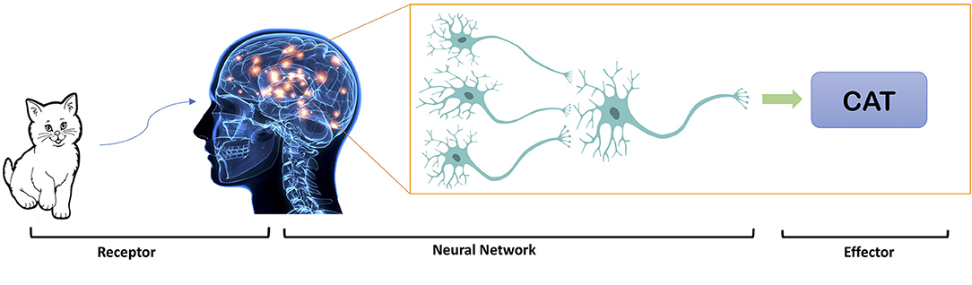
This Photo by Unknown Author is licensed under CC BY

Slide 3
Where Neural Networks Are Used
Image and face recognition
Speech recognition
Natural language processing
Recommendation systems
Medical diagnosis
Autonomous vehicles
Financial forecasting

Slide 4

Research corner 5 minutes
What’s the linear regression
What’s the linear regression formula
Why the linear regression is “weak” in both descriptive and predictive analysis?

Slide 5

Relation to Linear Regression
A net with a single output node and no hidden layers, where g is the identity function, takes the same form as a linear regression model

Slide 6
Basic Idea
Combine input information in a complex & flexible neural net “model”
Model “coefficients” are continually tweaked in an iterative process
The network’s interim performance in classification and prediction informs successive tweaks

Slide 7
Network Structure
Multiple layers
  Input layer (raw observations)
  Hidden layers
  Output layer

Slide 8
Network Structure
Nodes
  Weights (like coefficients, subject to iterative adjustment)
  Bias values (also like coefficients, subject to iterative adjustment)
  Activation function

Slide 9
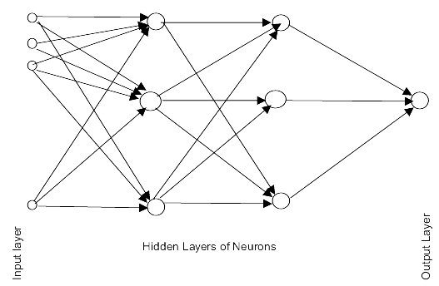
Schematic Diagram

Slide 10
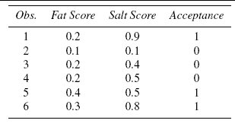
Example - Data

Slide 11
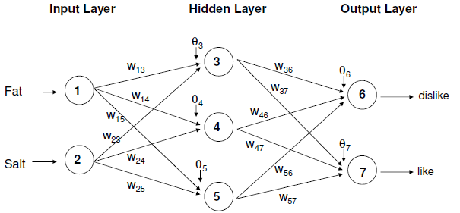
Example – Using fat & salt content to predict consumer acceptance of cheese
Circles are nodes, w_{ij} on arrows are weights, and ϴ_{j} are node bias values

Slide 12
Moving Through the Network

Slide 13
The Input Layer
For input layer, input = output
E.g., for record #1:
  Fat input = output = 0.2
  Salt input = output = 0.9
Output of input layer = input into hidden layer

Slide 14

The Hidden Layer
In this example, it has 3 nodes
Each node receives as input the output of all input nodes
Output of each hidden node is a function of the weighted sum of inputs

Slide 15
The Weights
The weights w and bias θ (theta) are typically initialized to random small uniform/normal
values in the range like e.g. -0.05, +0.01
Equivalent to a model with random prediction (in other words, no predictive value)
These initial weights are used in the first round of training

Slide 16

Neural net uses Sigmoid function to activate nodes!

Slide 17
Research corner 5 minutes
What’s sigmoid function?
Why to use sigmoid function in neural net?

Slide 18
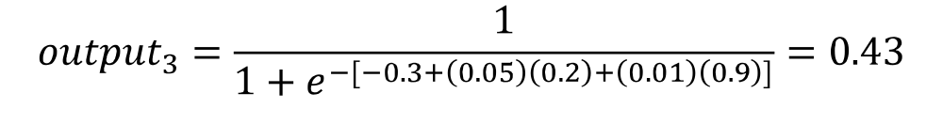
Output of Node 3 if g is a Logistic Function
θ
W
X
W
X

Slide 19
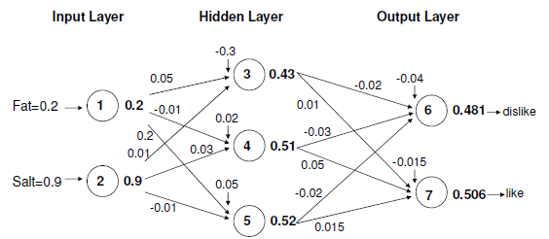
Initial Pass of the Network
Node outputs (bold) using first record in tiny example, and logistic function

Slide 20
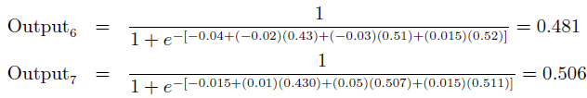
Output Layer
The output of the last hidden layer becomes input for the output layer
Uses same function as above, i.e. a function g of the weighted average
(-0.02)(0.52)

Slide 21
Mapping the output to a classification
Output = 0.506 for “like” and 0.481 for “dislike”
So classification, at this early stage, is“like”

Slide 22
Training the Model

Slide 23
Preprocessing Steps
Scale variables to 0-1
Categorical variables (map to dummy values 0-1 range)

Slide 24
Initial Pass Through Network
Goal: Find weights that yield best predictions
The process we described above is repeated for all records
At each record compare prediction to actual
Difference is the error for the output node
Error is propagated back and distributed to all the hidden nodes and used to update their weights

Slide 25

Error is Used to Update Weights
At each iteration (training step), the network:
Makes a prediction (forward pass)
Measures the error (loss)
Computes how each weight contributed to the error (backpropagation)
Updates the weights to reduce the error (gradient descent)

Slide 26



Error & Weight Update
Learning rate: η=0.1
Weight Update Rule:
Weight new value:

Slide 27
Why It Works
Big errors lead to big changes in weights
Small errors leave weights relatively unchanged
Over thousands of updates, a given weight keeps changing until the error associated with that weight is negligible, at which point weights change little

Slide 28
Common Criteria to Stop the Updating
When weights change very little from one iteration to the next
When the misclassification rate reaches a required threshold
When a limit on runs is reached

Slide 29
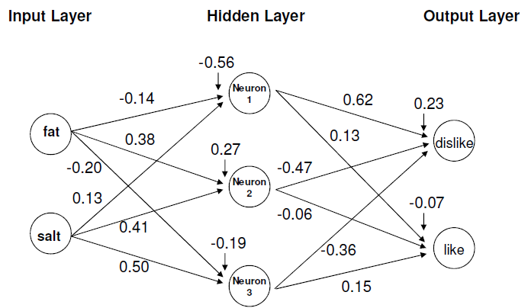
The output nodes in final network
Final weights from tiny example

Slide 30
Python Packages for Neural Nets
Most common for basic neural nets:
scikit-learn
For deep learning:
tensorflow
keras
pytorch

Slide 31
User Inputs

Slide 32
Specify Network Architecture
Number of hidden layers
  Most popular – one hidden layer
Number of nodes in each hidden layer
  Midway between input and output layers
  Less than 2X the input nodes
  2/3 input nodes + output nodes
Number of output nodes
  For classification, one node per class (in binary case can also use one)
  For numerical prediction use one

Slide 33
Advantages
Learn complex, non-linear patterns
Highly scalable
Excellent performance with large datasets

Slide 34
Limitations
Require lots of data
Computationally expensive
Often hard to interpret (“black box”)

Slide 35
Summary
Neural networks can be used for classification and prediction
Can capture a very flexible/complicated relationship between the outcome and a set of predictors
The network “learns” and updates its model iteratively as more data are fed into it
Requires large amounts of data
Good predictive performance, yet “black box” in nature

Slide 36

Fun Task
Neural Networks

